Slide 1

QUIZ GAME
PRESENTED BY :
Manila Aryal
Anshu Hada
Kamana Shrestha
Bsc.CSIT 1st Semester

Slide 2

INTRODUCTION
A Quiz is a form of game or mind sport in which players attempt to answer questions correctly on one or several specific topics.

Slide 3

Features
Starting the game
Check Answers if they are correct/wrong
Get the Final Score

Slide 4
FLOWCHART OF THE QUIZ GAME
START
MAIN MENU
USER INPUT
START OR QUIT
Q
S
A

Slide 5
A
QUIT GAME
DISPLAY SCORE
STOP

Slide 6

Objective
Create a simple and entertaining game.
Enhance users IQ level in entertaining way.
The users can easily learn different kinds of knowledge about variety of subjects

Slide 7

Methodology
1. Objectives
The goal of this program is to develop an interactive IQ test game where participants can respond to multiple-choice questions and promptly receive feedback on their answers.
2. Implementation
Programming language: Implemented in C.
Libraries used: The program utilizes standard C libraries (stdio.h, stdlib.h, conio.h, ctype.h) for performing input/output operations, managing memory, handling console input, and validating character types, respectively.

Slide 8
Methodology
3. Key Functions and their Roll
mainMenu(): This function displays the main menu interface and manages user input to initiate the game or terminate the program.
gamePlay(): Responsible for executing the central gameplay loop, this function presents questions, validates user responses, and provides immediate feedback based on correctness.
gotoxy() (Assumed from gotoxy.h): This function, inferred from gotoxy.h, facilitates text positioning within the console interface, contributing to a more refined user experience.
4. Testing and Validation
Valid inputs including 'S', 'Q', 'ESC', and legitimate answer choices 'a', 'b', 'c', 'd'.
Extensive checks for error handling to verify correct operation when encountering invalid inputs.
Testing of edge cases such as boundary values and extreme inputs to ensure robust functionality across all potential use cases.

Slide 9

Conclusions
To conclude, the IQ test game program offers an interactive and stimulating experience for users to assess their knowledge through a variety of multiple-choice questions. The program effectively integrates essential features including menu presentation, question display with selectable options, validation of user inputs, and prompt feedback on accuracy.
By using standard C libraries for tasks like handling input/output, managing memory, and controlling the console, along with a specific function (gotoxy()) for placing text accurately on the screen, the program ensures smooth and user-friendly interaction.

Slide 10
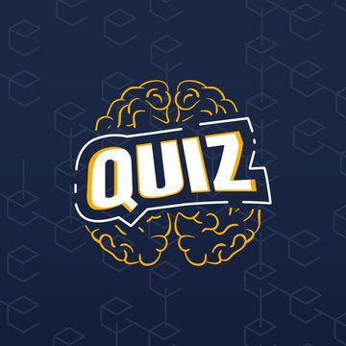
Thank You

